Slide 1
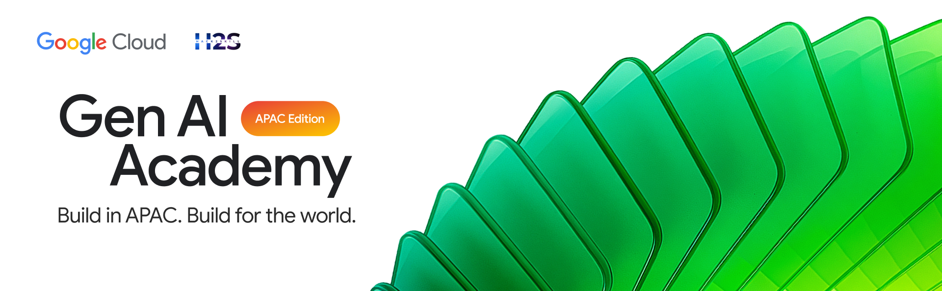
PARTICIPANT DETAILS a. Participant name : Hariharan C b. Problem Statement : Build an AI agent that uses the Model Context Protocol (MCP) to connect to one external tool or data source, retrieve information, and use that information in its response. c. Github repo link : https://github.com/BlackWizard123/Track-2---Medical_MCP_agent d. Cloud Run URL : https://medical-agent-1059652519537.us-central1.run.app/chat

Slide 2
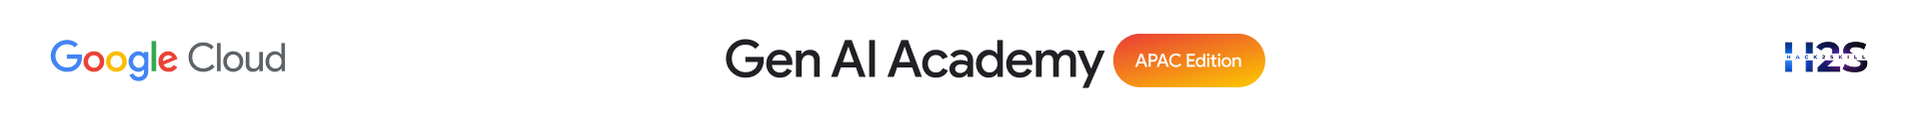
Brief about the idea
MediChat is an AI-powered medical assistant agent
Provides quick, reliable, and structured medical information
Uses Google ADK + Gemini 2.5 Flash for intelligent responses
Connects to a structured medical knowledge base via MCP
Dynamically retrieves data using specialized tools (disease info & remedies)
Ensures safe responses with medical disclaimers
Deployed on Google Cloud Run for scalable, real-time access

Slide 3
Meeting the Build Criteria How did you navigate the requirements of your chosen track to build a custom solution - using ADK, MCP, or AlloyDB AI that effectively addresses the 'What You Must Build' criteria?
Built the agent using Google ADK to manage sessions, tool calling, and response generation
Created a custom structured knowledge base (data.json) containing medical data
Implemented two MCP tools:
1. disease_info → symptoms, causes, precautions
2. disease_remedy → treatments, when to consult a doctor
Enabled intent-based tool selection, where the agent decides which tool to call dynamically
Integrated Model Context Protocol (MCP) using FastMCP to connect the agent with an external data source
Ensured the agent retrieves real data instead of relying only on LLM knowledge
Generated final responses using retrieved structured data + Gemini reasoning
Deployed the complete system on Google Cloud Run for real-world accessibility

Slide 4
Opportunities
How different is it from any of the other existing ideas?
Uses MCP-based structured data retrieval instead of relying only on LLM-generated answers
How will it be able to solve the problem?
Provides accurate, reliable, and instantly accessible medical information through a structured knowledge base
USP of the proposed solution
Intent-driven tool calling with safety-first responses, ensuring relevant and trustworthy outputs

Slide 5
List of features offered by the solution
AI-powered medical assistant agent for quick queries
MCP-based integration with structured medical knowledge base
Two specialized tools: disease information & remedies
Intent-based tool selection for accurate responses
Structured and easy-to-understand outputs
Safety-first responses with medical disclaimer
Real-time interaction via chat UI
Scalable deployment on Google Cloud Run

Slide 6
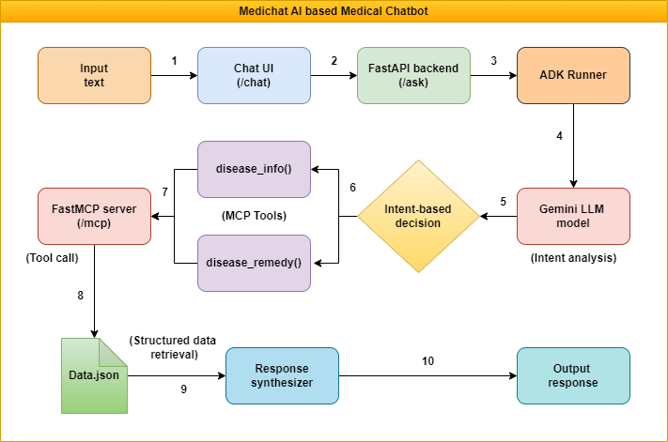
Process flow diagram or Use-case diagram

Slide 7
Technologies used in the solution
Google ADK (Agent Development Kit) — for building and orchestrating the AI agent
Gemini 1.5 Flash — for fast and efficient LLM-based reasoning
FastMCP — to expose tools as MCP-compatible endpoints
FastAPI + Uvicorn — for backend API and request handling
Vanilla HTML, CSS, JavaScript — for lightweight chat UI
Docker — for containerization
Google Cloud Run — for scalable, serverless deployment
Python 3.12 — core development language
Model Context Protocol (MCP) — for standardized tool and data integration

Slide 8
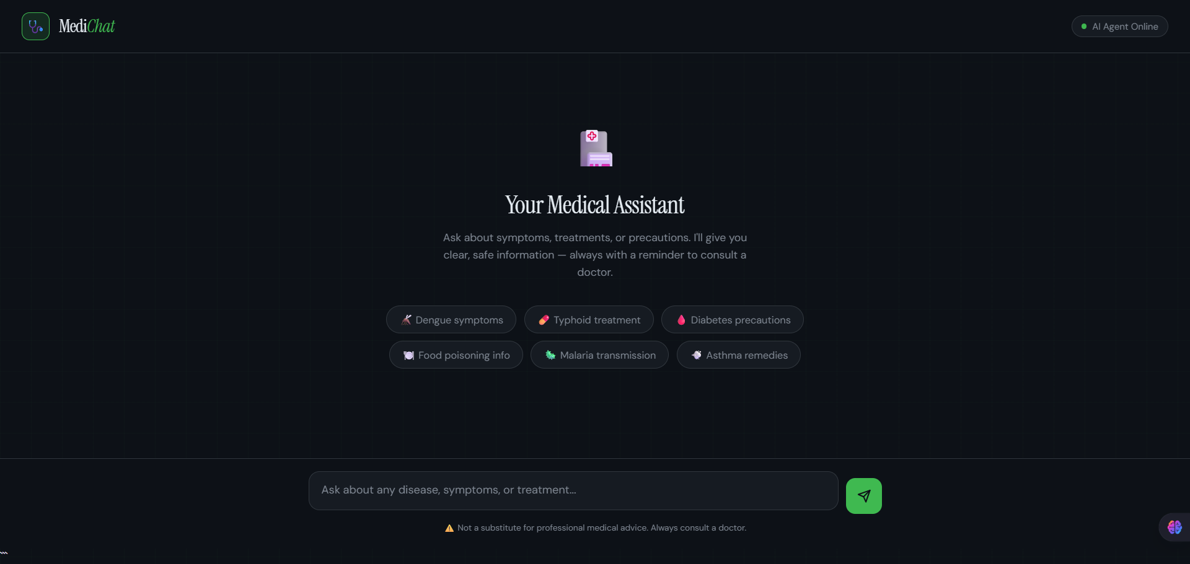
Snapshots of the prototype
https://medical-agent-1059652519537.us-central1.run.app/chat

Slide 9
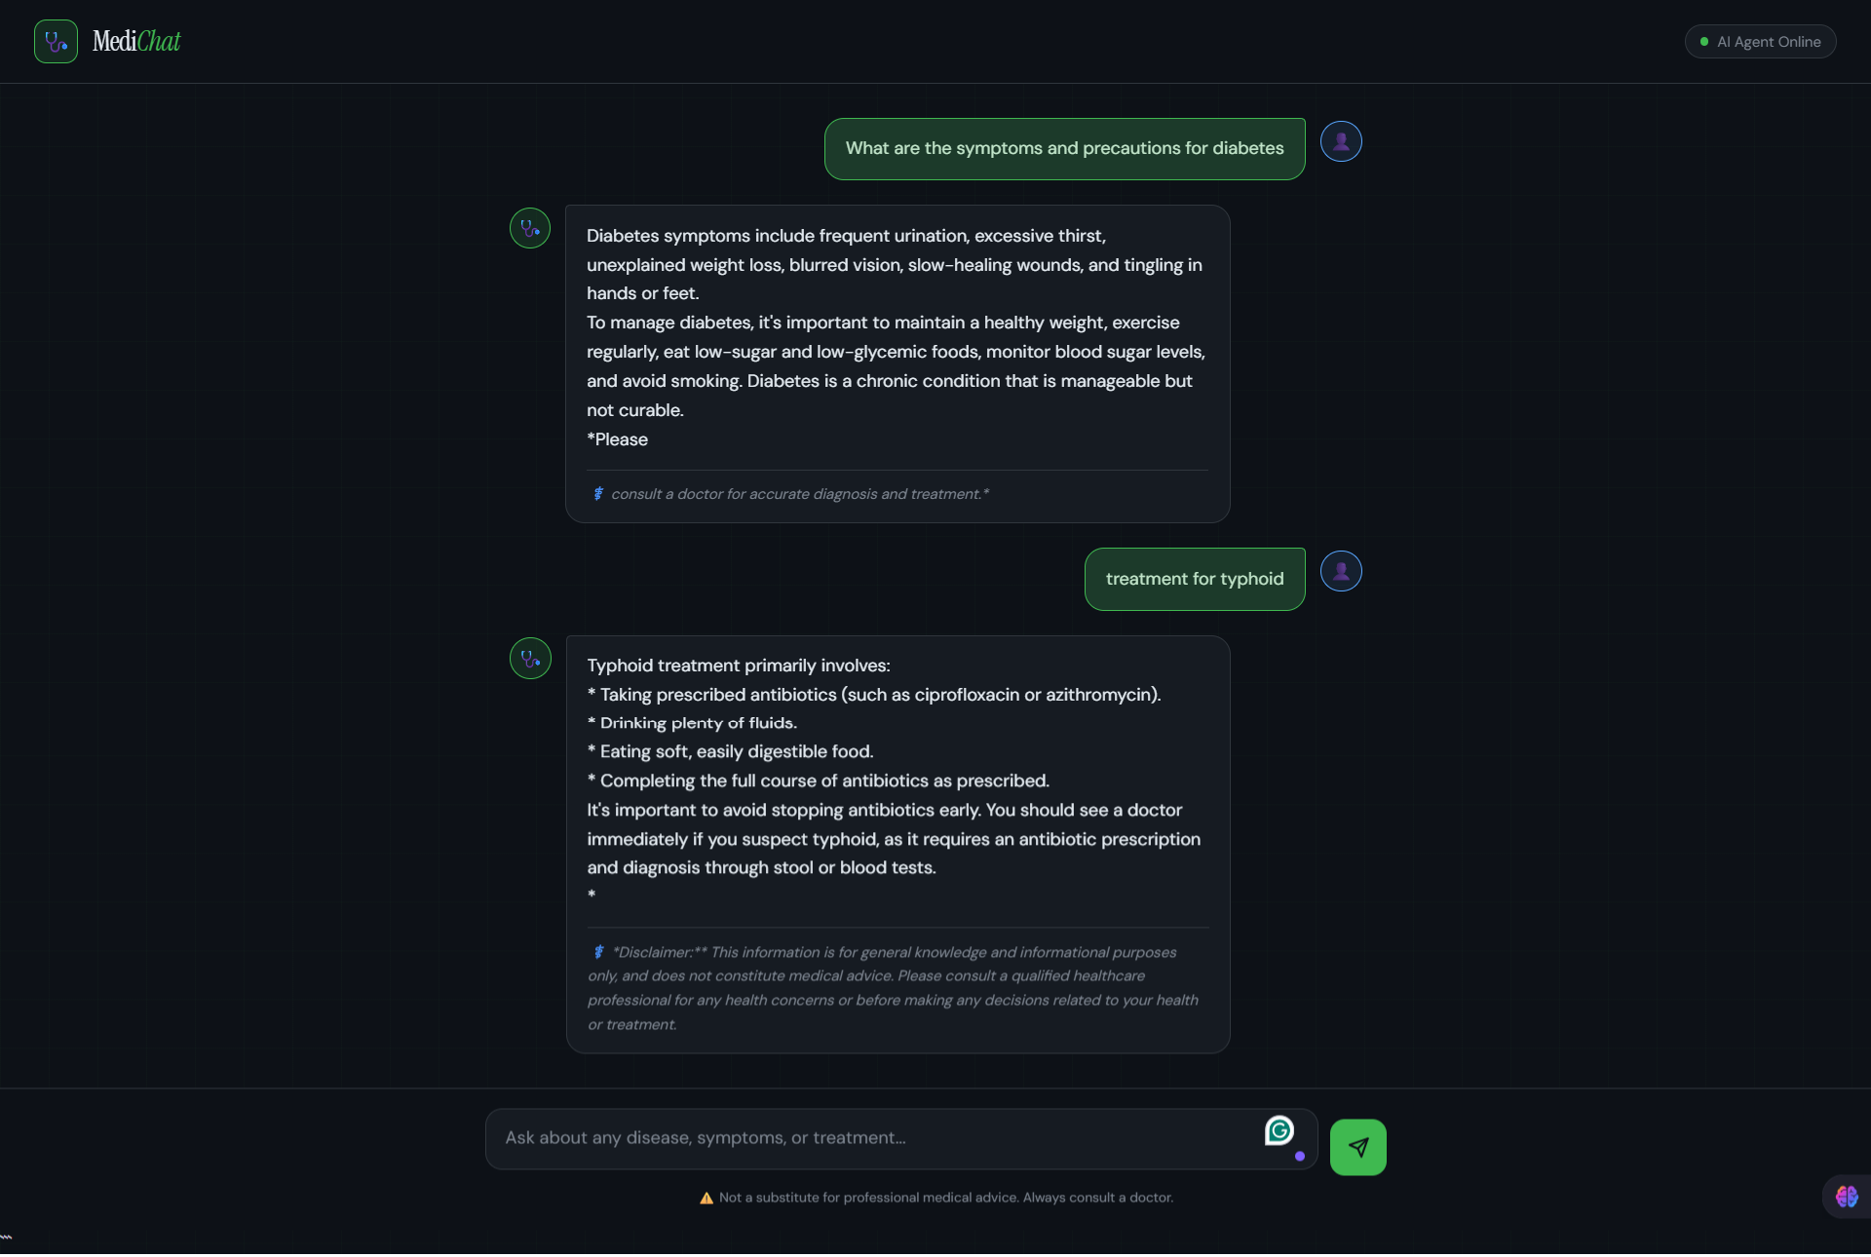
https://medical-agent-1059652519537.us-central1.run.app/chat

Slide 10
